Slide 1
MUSIC
&
VEX

Slide 2
Music Beat!
Today you will create your own musical code.
Let’s write a musical rhythm that others can follow using
VEX GO pieces.

Slide 3
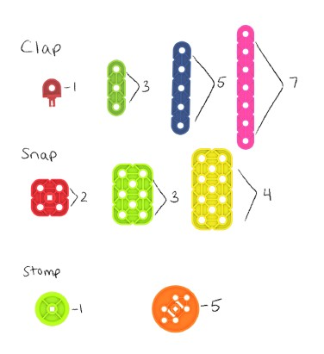
Musical Code:
CLAP
PAT
STOMP

Slide 4

CLAP
PAT
STOMP
Use the musical code to play the “song” below.

Slide 5


Use the musical code to play the “song” below.
CLAP
PAT
STOMP

Slide 6
Now you try it!
Choose 4 VEX GO pieces to create your own musical code.

Slide 7
Thanks!
Do you have any questions?
youremail@freepik.com
+91 620 421 838
yourcompany.com
Please keep this slide for attribution

